Slide 1

Object Tracking with YOLO and Streamlit
This app provides a user-friendly interface for object tracking in videos using YOLO, a state-of-the-art object detection algorithm.

Slide 2
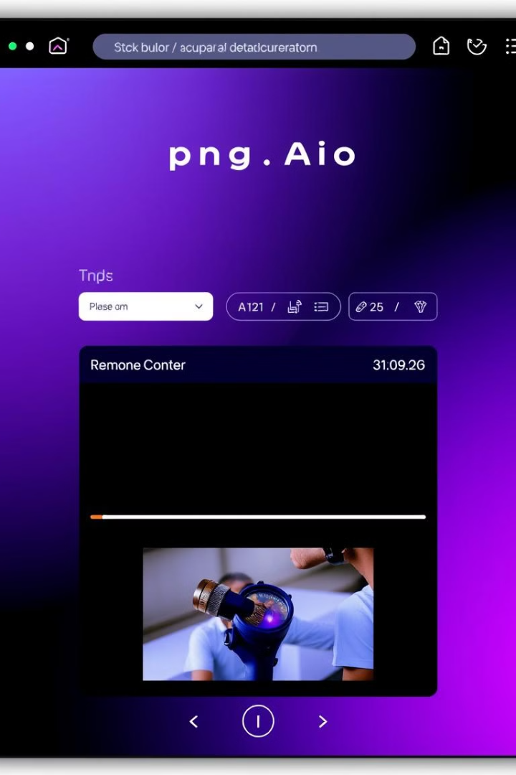
Introduction to the app and its features
1
Video Upload
2
Real-Time Tracking
Upload any video file for analysis.
The app tracks objects frame by frame, providing accurate and timely data.
3
Interactive Timeline
4
Data Export
Explore object activity over time with an interactive timeline graph.
Download tracking data in a JSON file for further analysis and insights.

Slide 3
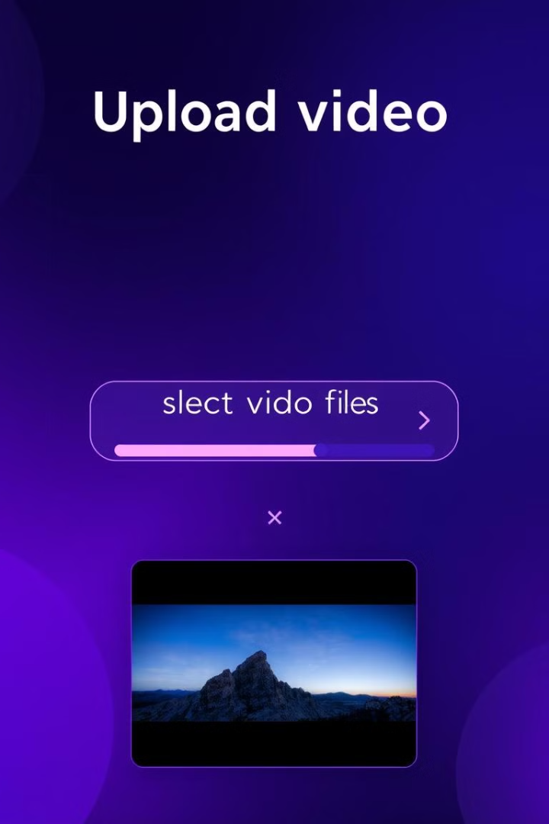



Uploading a video for object detection
Select File
Users select a video file from their computer.
Upload
The selected video is uploaded to the app's server.
Processing
The video is processed by YOLO to identify objects.

Slide 4
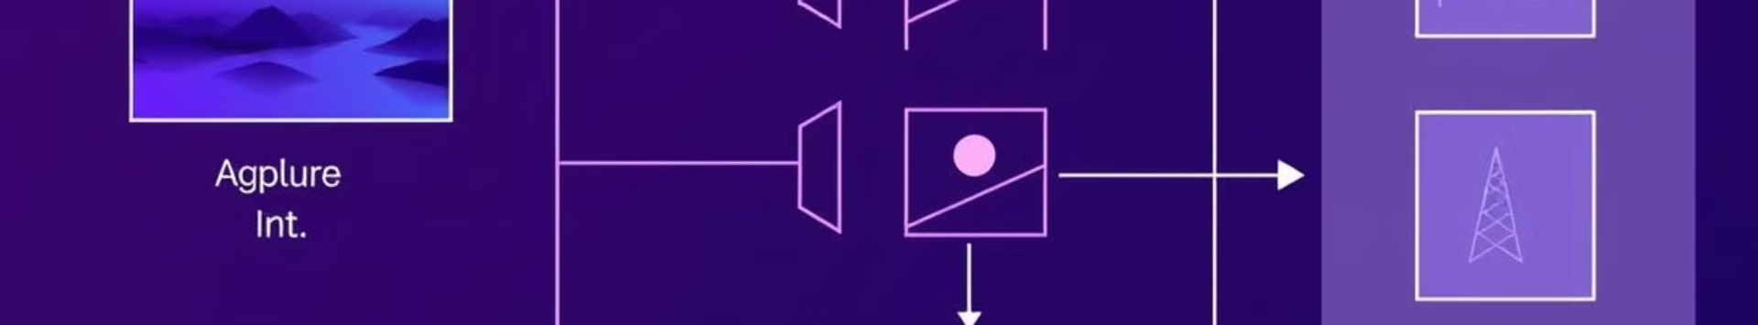
How YOLO powers the object detection
Object Recognition
Bounding Boxes
Confidence Scores
YOLO identifies objects in each frame of the video.
Bounding boxes are drawn around detected objects, indicating their location and size.
YOLO assigns confidence scores to each detection, indicating the probability of an object being correctly identified.

Slide 5
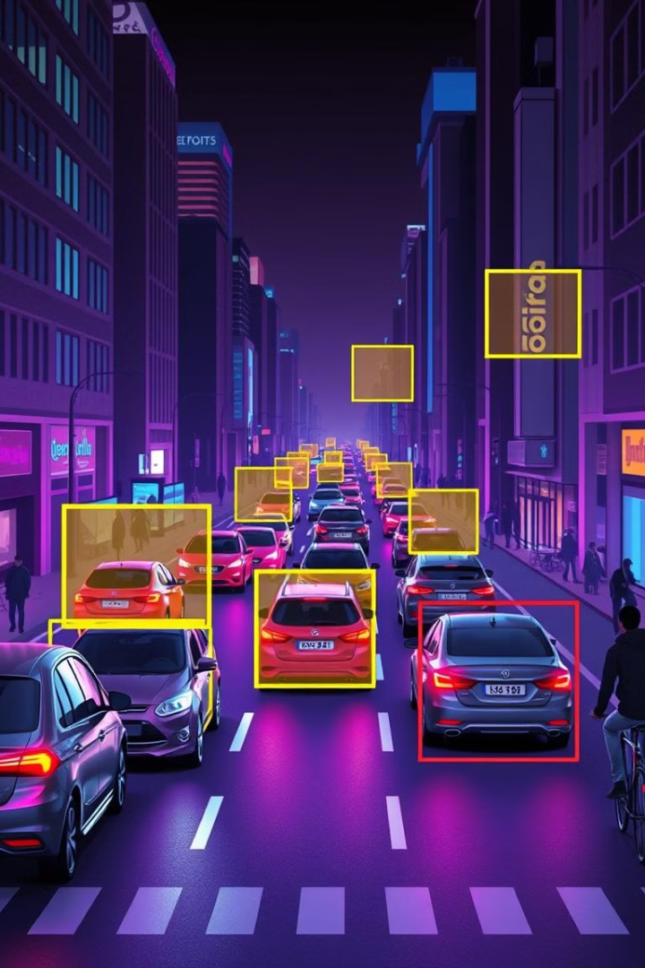
Frame-by-frame object tracking
1
Frame Processing
Each frame is analyzed independently.
2
Object Detection
Objects are detected and their bounding boxes are recorded.
3
Tracking
The app tracks objects across frames based on their location and identity.

Slide 6
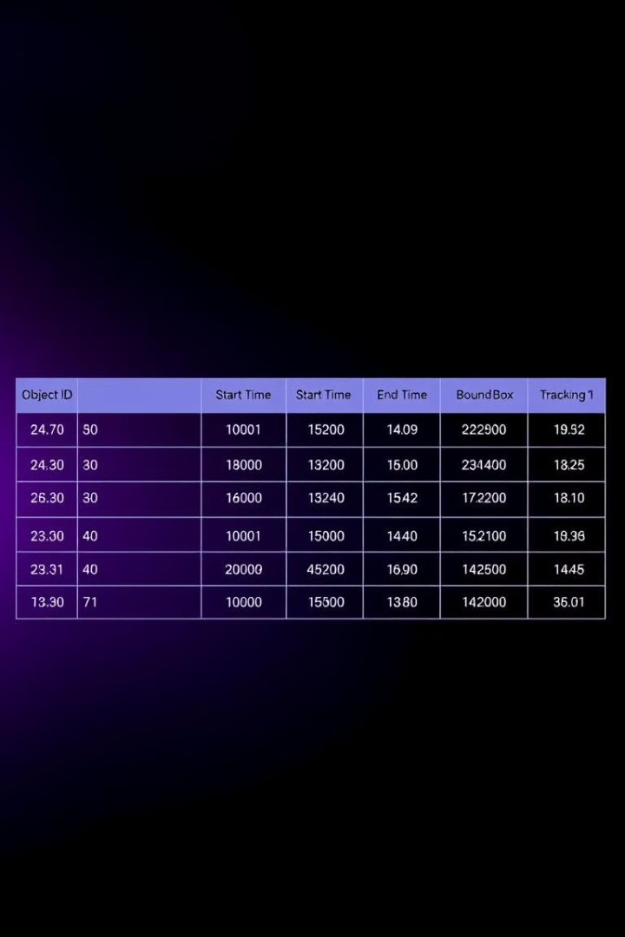
Tracking data: start/end times and bounding boxes
Object ID
Start Time
End Time
Bounding Box Coordinates
1
00:00:05
00:00:15
(100, 150, 200, 250)
2
00:00:10
00:00:20
(250, 100, 350, 200)

Slide 7
Displaying the processed video with annotations
Bounding Boxes
Object Labels
Tracking IDs
Each detected object is outlined with a bounding box.
Labels indicate the class of each object, such as "car" or "person."
Unique identifiers are assigned to each object for tracking purposes.

Slide 8
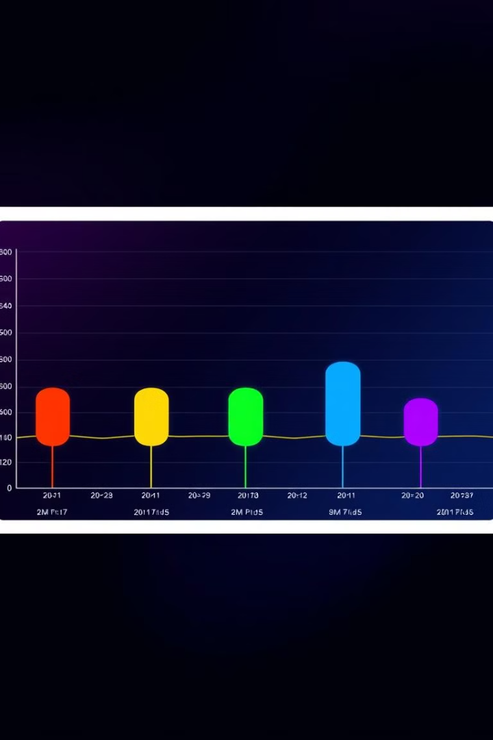



Generating the object activity timeline graph
Time Axis
The horizontal axis represents time.
Object Lines
Each object is represented by a colored line.
Activity Periods
The colored lines indicate when each object is present
in the video.

Slide 9

Saving the tracking data in a JSON file
The app allows users to download the tracking data in a JSON file, making it easy to analyze the data further or integrate it into other systems.

Slide 10
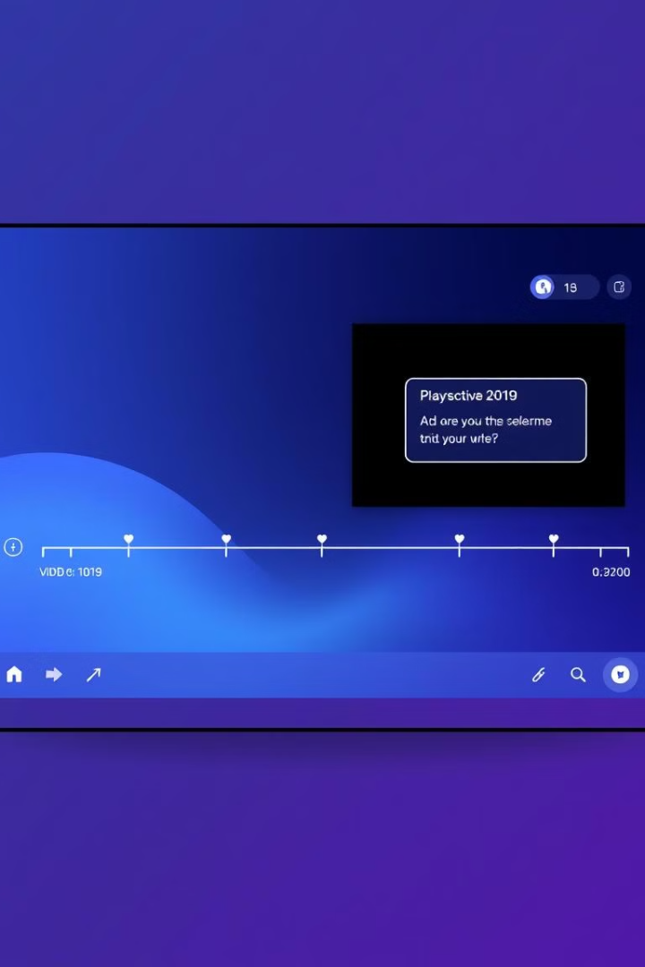
Scope of improvement: Interactive timeline, user-defined annotations
Future improvements include enhancing the timeline graph to allow users to zoom, pan, and filter the data, and allowing users to add their own annotations to the video.

